Slide 1
Industry CASE STUDY ANALYSIS
SOCIAL Media – Dashboard
BY: Pranav Malik
Reg no: 12325012

Slide 2
introduction
Instagram as a popular social networking platform that focuses on photo and video sharing.
it's essential to highlight the significance of the case study, why it's relevant, and what insights or lessons it could provide for businesses, marketers, regulators, or users of the platform.
it's essential to highlight the significance of the case study, why it's relevant, and what insights or lessons it could provide for businesses, marketers, regulators, or users of the platform.

Slide 3
Data extracted link
kaggle datasets download -d bhanupratapbiswas/instagram-reach-analysis-case-study

Slide 4
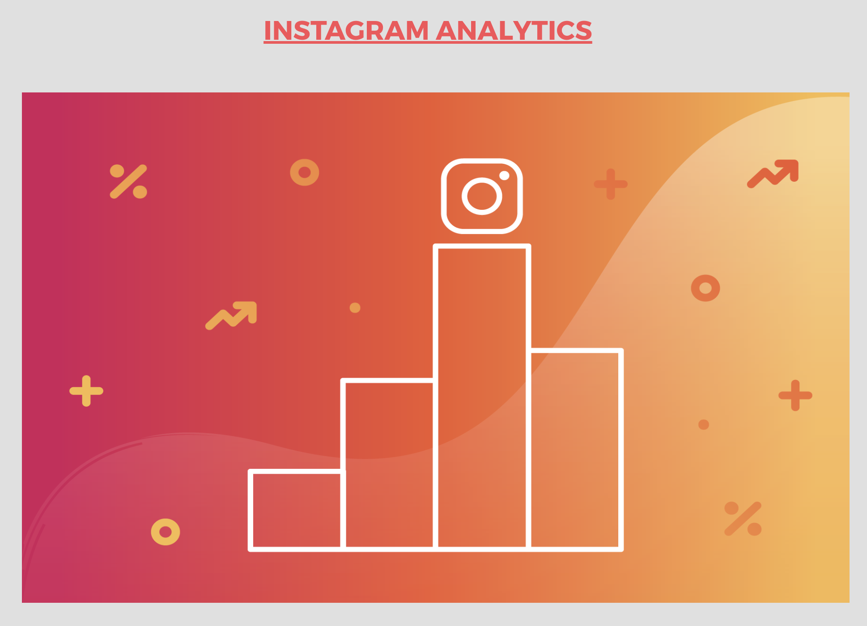
Cover page

Slide 5
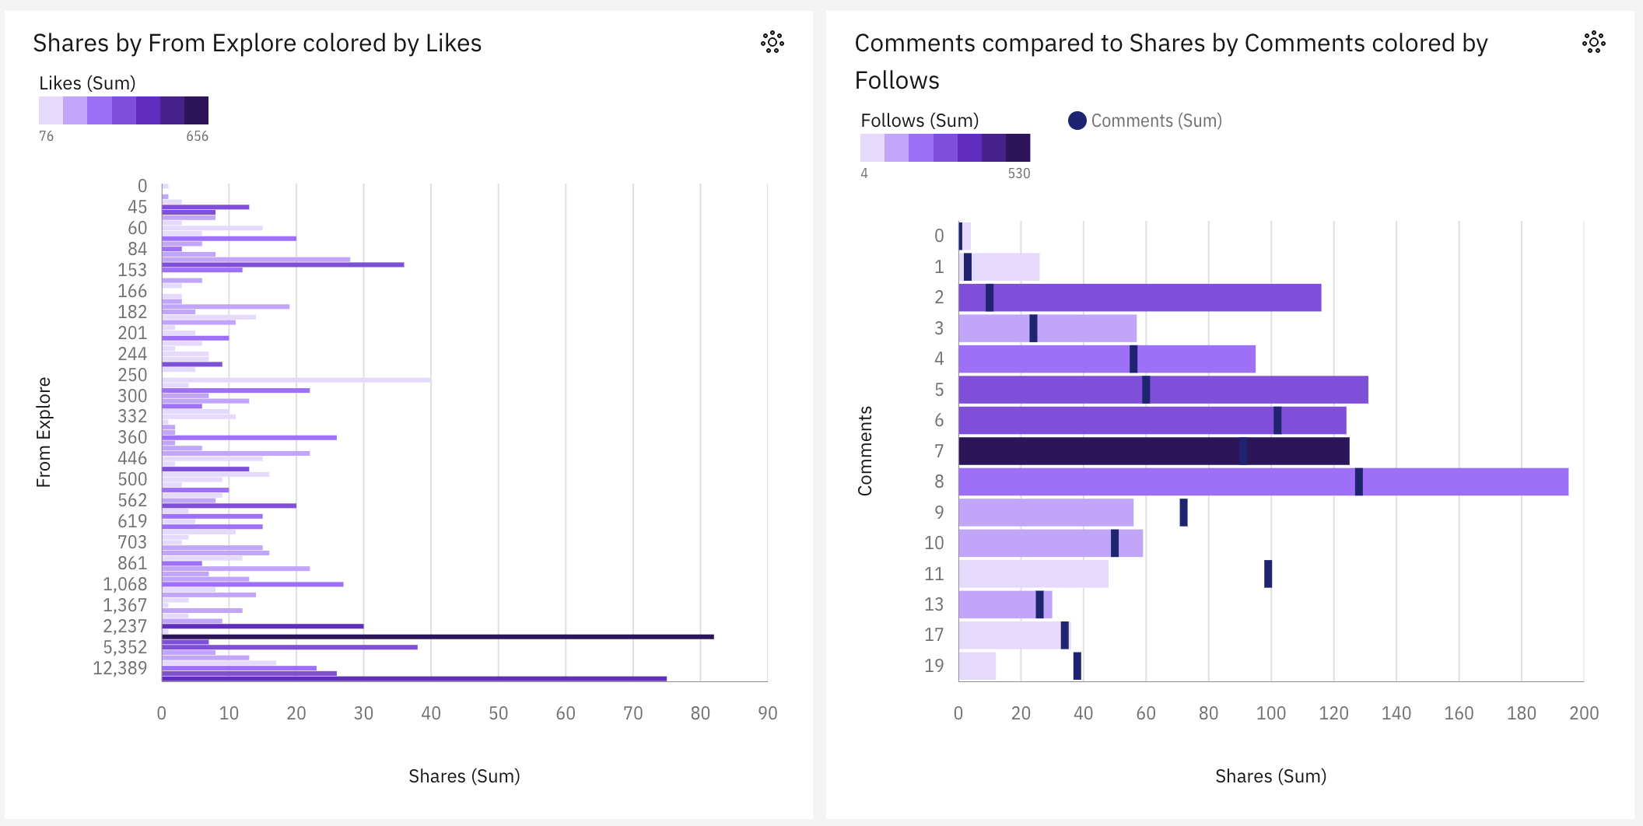
Engagement Metrics Analysis: Shares vs. Follows.
It appears to show two line graphs that depict the number of shares, likes, and comments received by a Facebook post, seemingly broken down by the post's origin and how users found it.

Slide 6
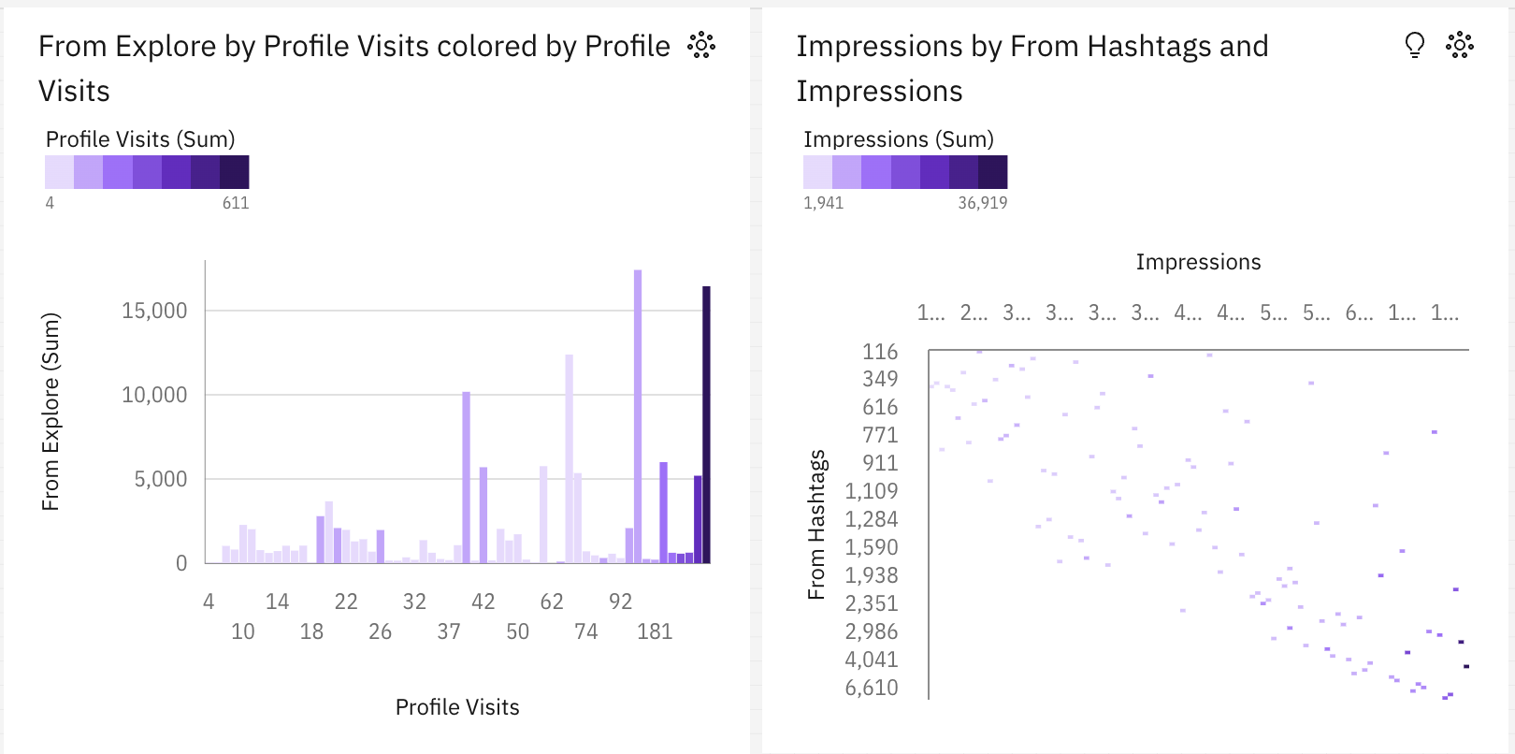
User Engagement Analysis: Profile Visits vs. Impressions by Hashtags.
Visits (sum): There is a steady increase in the number of profile visits over time.
Impressions (sum) from Explore by Profile Visits: This line generally follows the same trend as profile visits, but with some fluctuations.
Impressions (sum) from Hashtags: This line shows a more volatile pattern, with some spikes and dips throughout the time period.

Slide 7
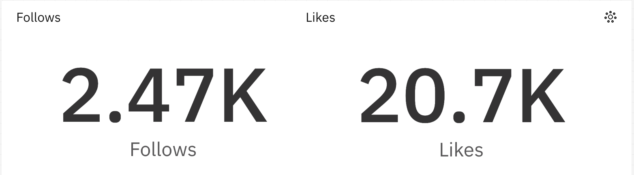
Total likes and follows

Slide 8
conclusion
This dataset provides a valuable resource for anyone interested in analyzing user sentiment and opinions towards the Instagram app on Android. However, it's important to consider potential limitations and biases when drawing conclusions.
Large and diverse collection: Over 47,000 reviews offer a sizable amount of data from various users.

